Slide 1

Session 1

Slide 2
K-Nearest Neighbor

Slide 3
Roadmap
•
Why do we need KNN?
•
What is KNN?
•
How to do we choose the factor ‘k’?
•
When do we use KNN?
•
Example

Slide 4
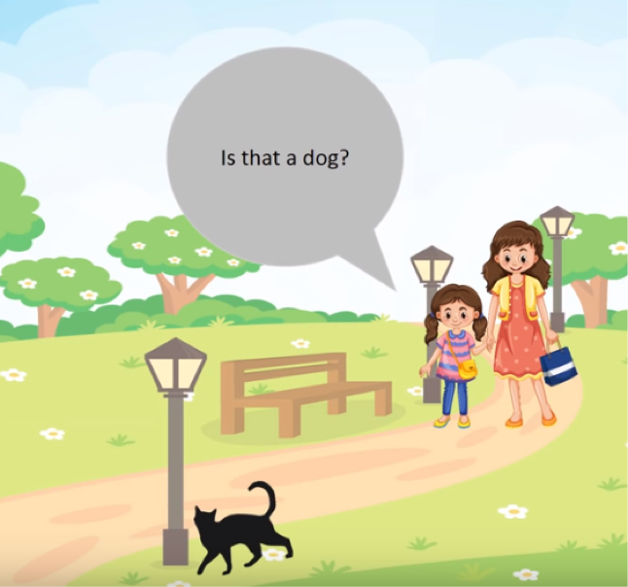
Why do we need KNN?

Slide 5
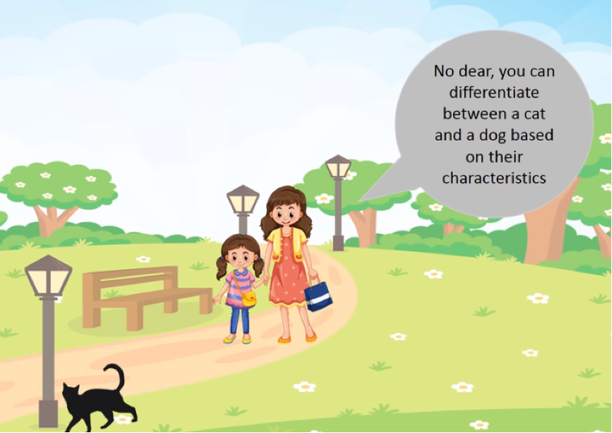
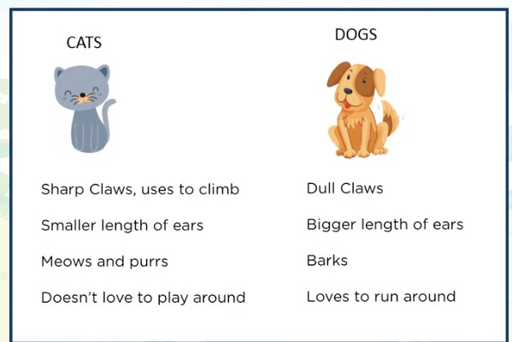
Why do we need KNN?

Slide 6
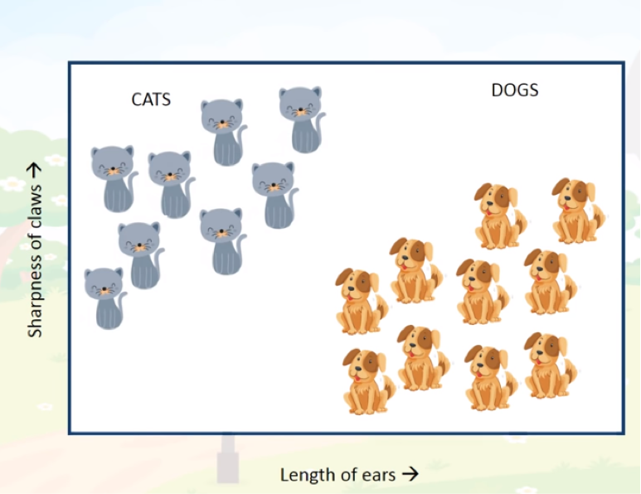
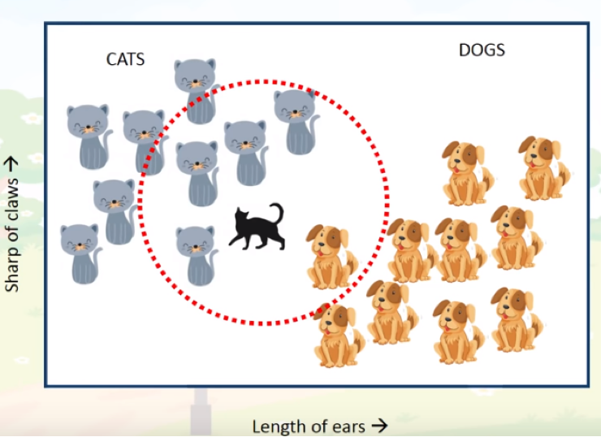
Why do we need KNN?

Slide 7
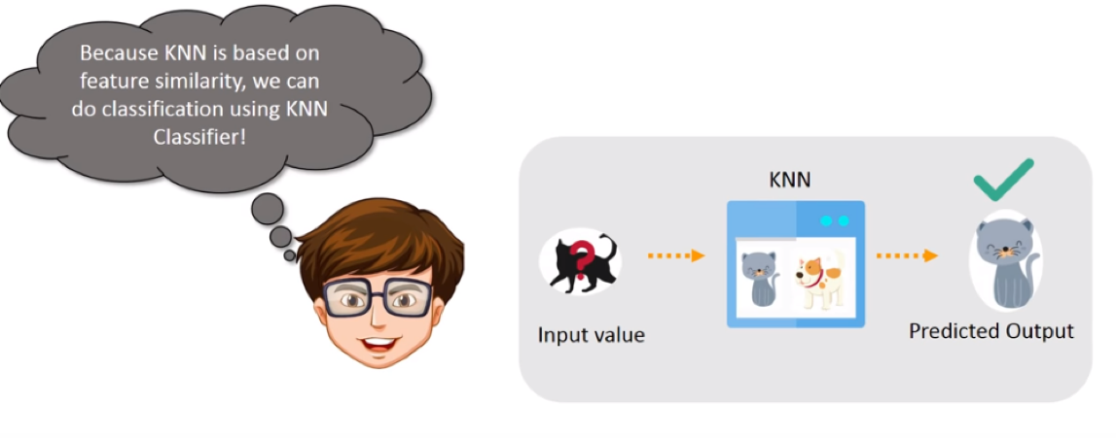
Why KNN?

Slide 8
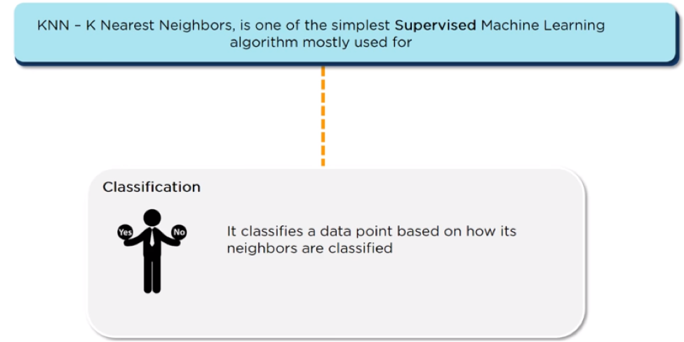
What is KNN algorithm?

Slide 9
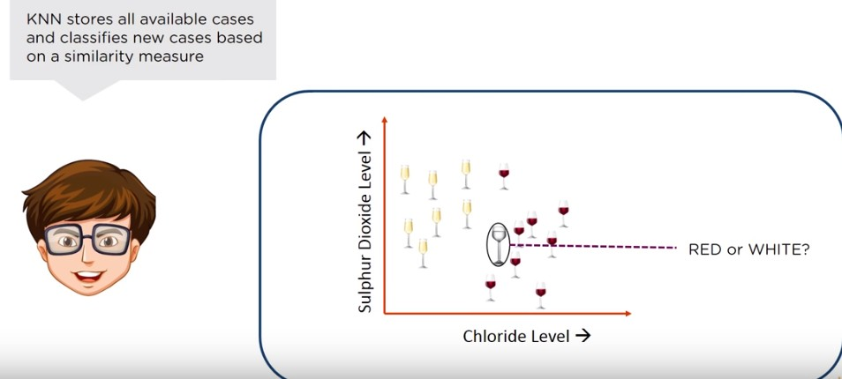
What is KNN algorithm?

Slide 10
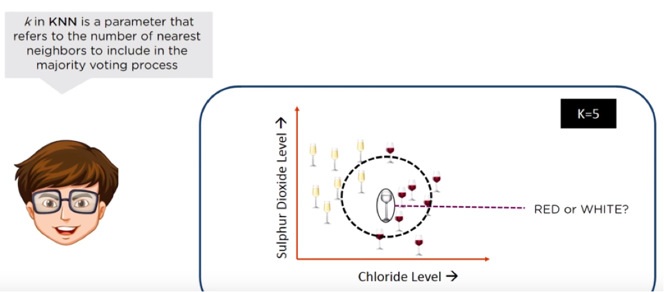
What is KNN algorithm?

Slide 11
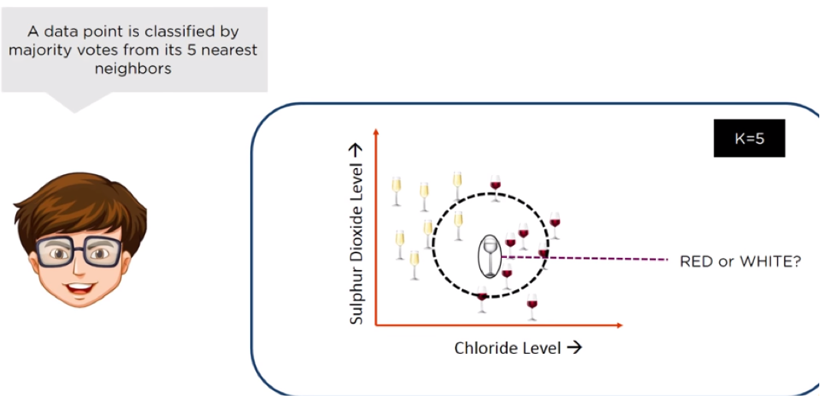
What is KNN algorithm?

Slide 12
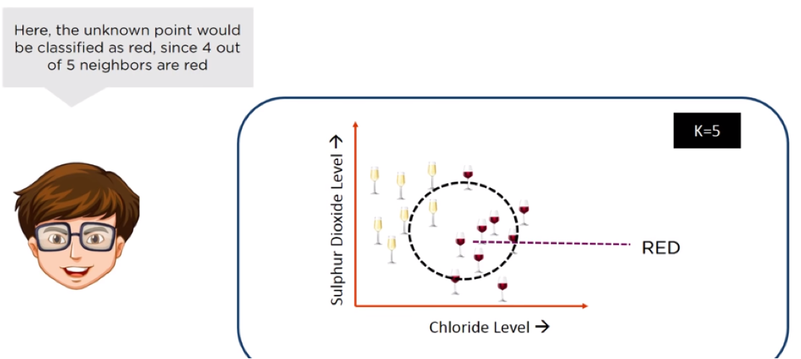
What is KNN algorithm?

Slide 13
KNN Algorithm
Load the data
Initialize K to your chosen number of neighbors
For each example in the data
Calculate the distance between the query example and the current example from the data.
Add the distance and the index of the example to an ordered collection
Sort the ordered collection of distances and indices from smallest to largest (in ascending order) by the distances
Pick the first K entries from the sorted collection
Get the labels of the selected K entries
If regression, return the mean of the K labels
If classification, return the mode of the K labels

Slide 14
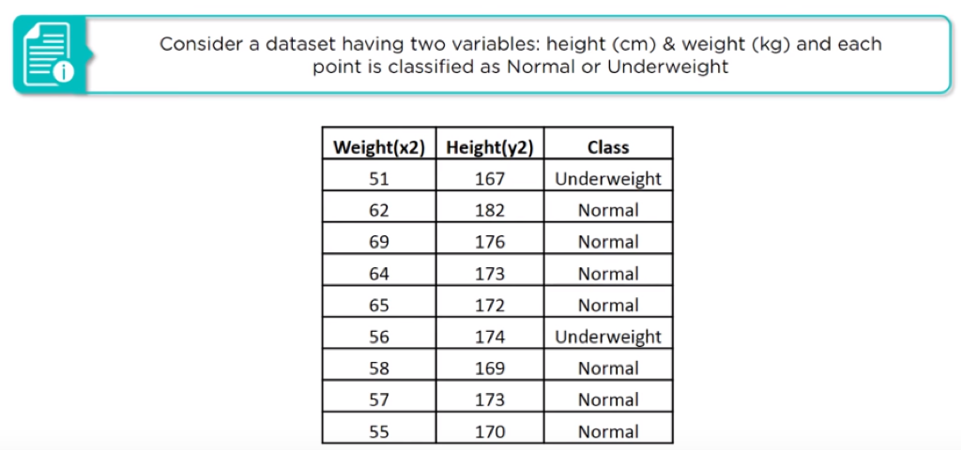
How does KNN Works?

Slide 15
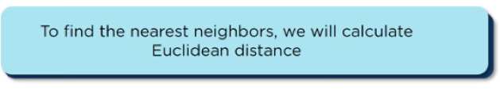
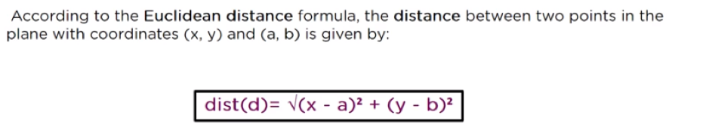
How does KNN Works?

Slide 16
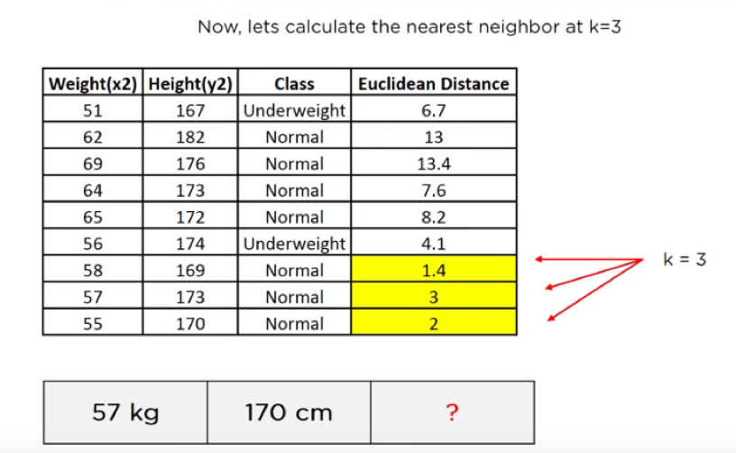
How does KNN Works?

Slide 17
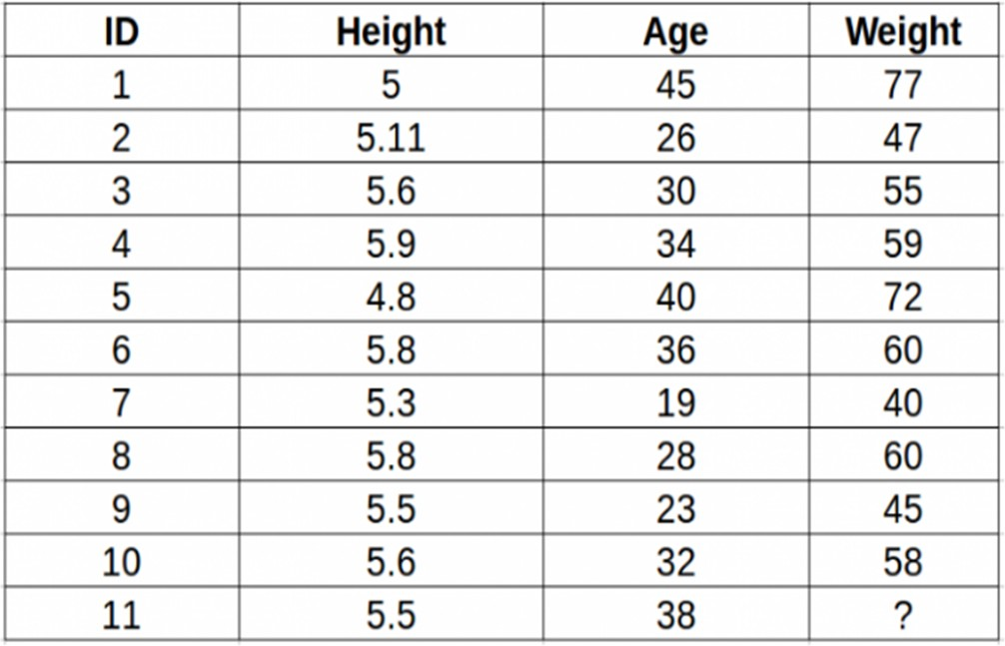
Example-2 Prediction
Consider the following table – it consists of the height, age and weight (target) value for 10 people. As you can see, the weight value of ID-11 is missing. Predict the weight of this person based on their height and age.

Slide 18
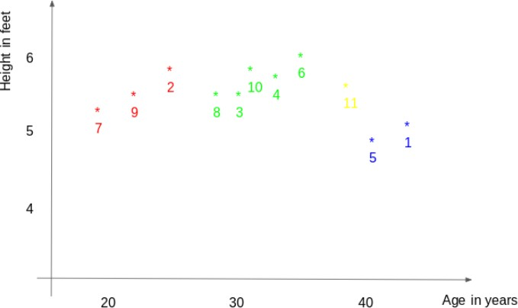
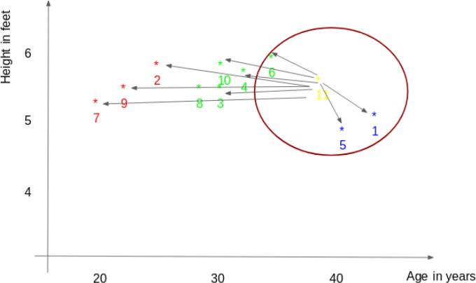
Example2 - Prediction

Slide 19
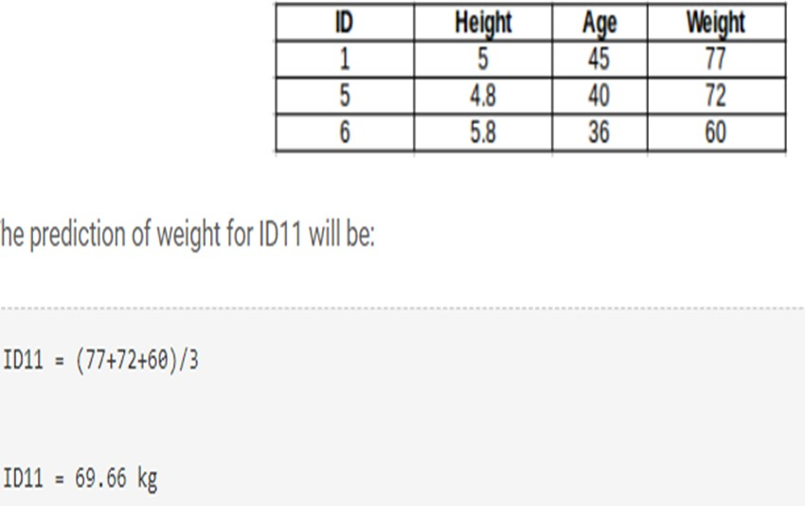
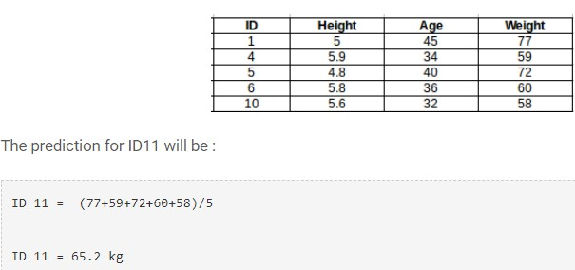
Solution

Slide 20
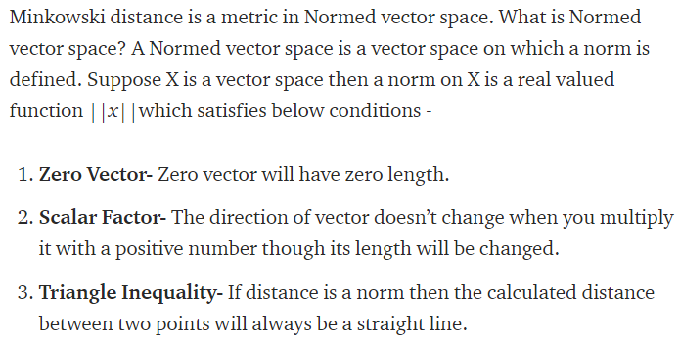
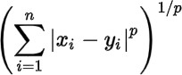
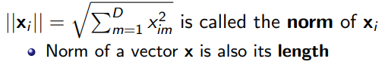
Distance Measure - Minkowski
Minkowski distance is the generalized distance metric. Here generalized means that we can manipulate the above formula to calculate the distance between two data points in different ways.
p = 1, Manhattan Distance
p = 2, Euclidean Distance
p = ∞, Chebychev Distance

Slide 21
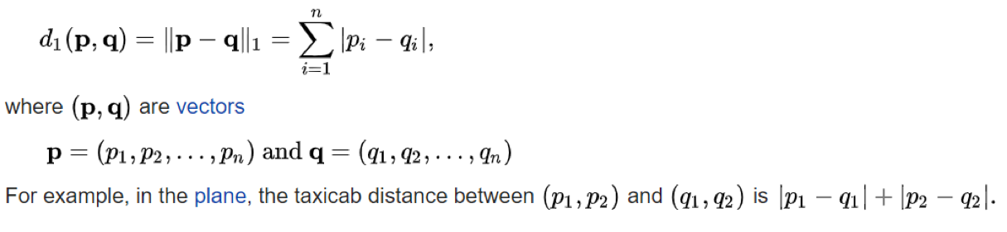
Distance Measure - Manhattan distance
the distance between two points is the sum of the absolute differences.
City block distance, L₁ distance
The distance between p and q in n-dimensional space,

Slide 22
Euclidean Vs Manhattan
•
Euclidean is a good distance measure to use if the input variables are similar in type
•
•
All measured widths and heights
Manhattan distance is a good measure to use if the input variables are not similar in type
•
Example such as age, gender, height, etc.

Slide 23
Methods of calculating distance between points
The first step is to calculate the distance between the new point and each training point. There are various methods for calculating this distance, of which the most commonly known methods are – Euclidian, Manhattan (for continuous) and Hamming distance (for categorical).
Euclidean Distance: Euclidean distance is calculated as the square root of the sum of the squared differences between a new point (x) and an existing point (y).
Manhattan Distance : This is the distance between real vectors using the sum of their absolute difference.
Hamming Distance: It is used for categorical variables. If the value (x) and the value (y) are same, the distance D will be equal to 0 . Otherwise D=1.

Slide 24
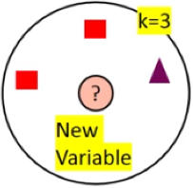
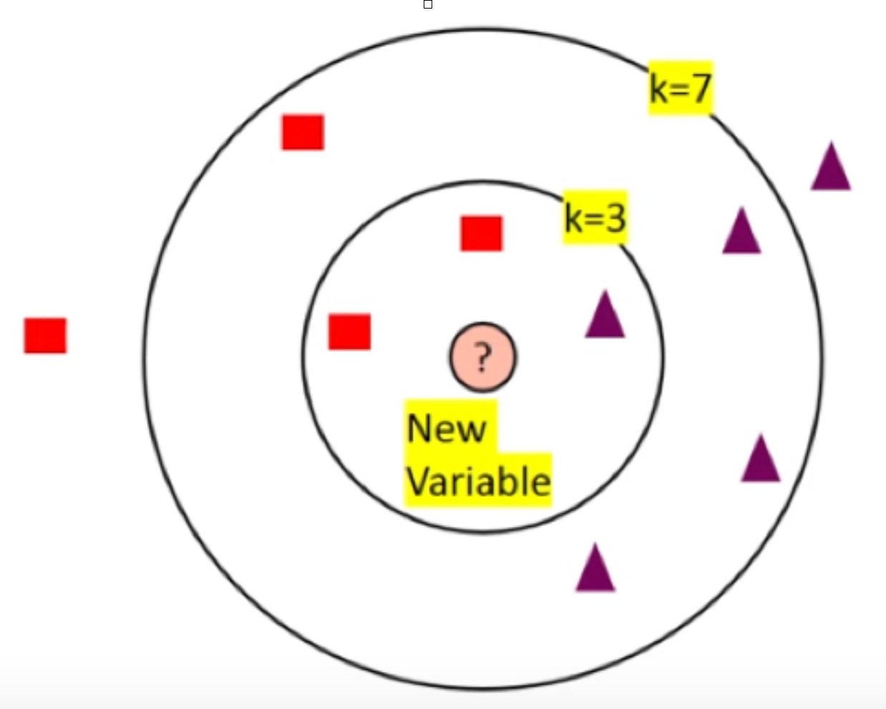
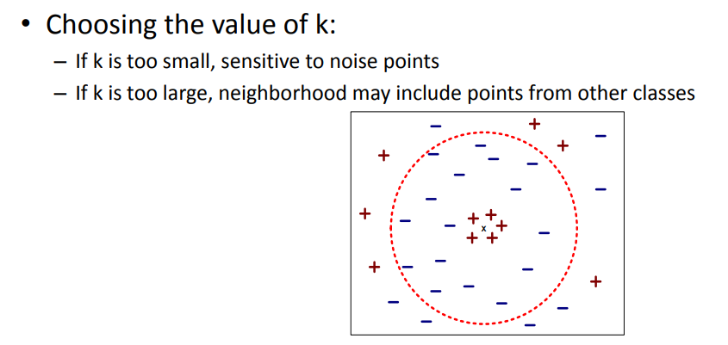
How do we choose ‘k’?
KNN Algorithms is based on feature similarly: Choosing the right value of k is a process called parameter tuning, and is important for better accuracy.
But at k=7, we can classify ‘?’ As “Purple”
So at k=3, we can classify ‘?’ As “Red”

Slide 25
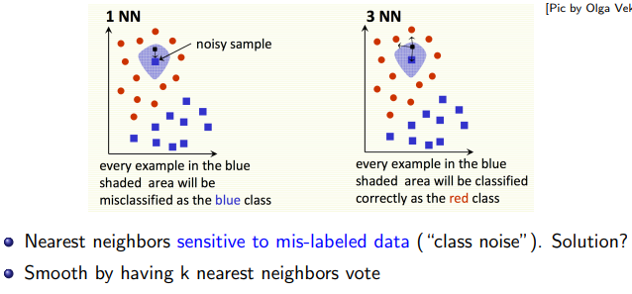

Slide 26
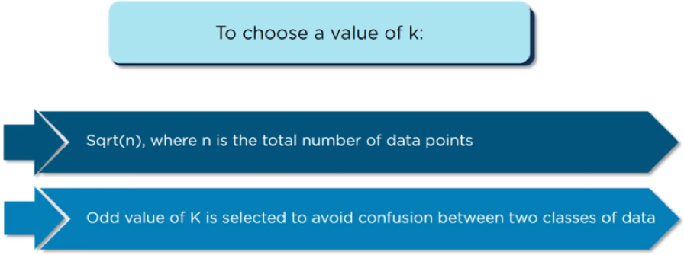
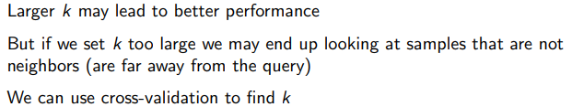
How do we choose ‘k’?

Slide 27
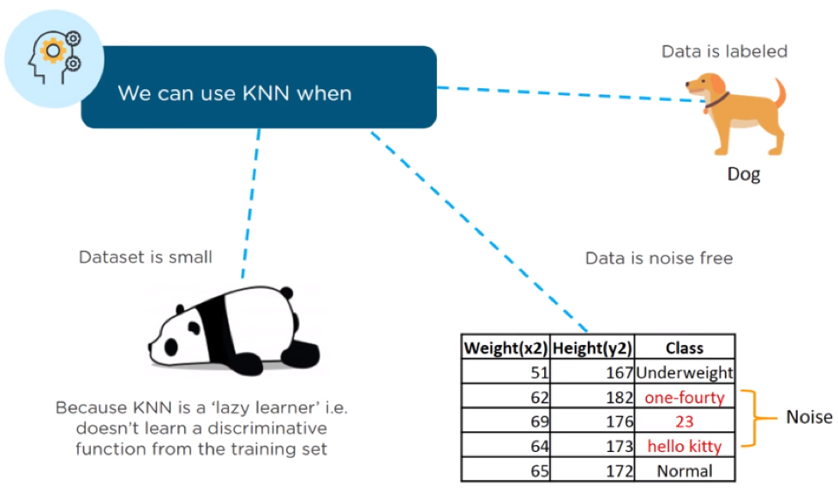
When do we use KNN algorithm?

Slide 28
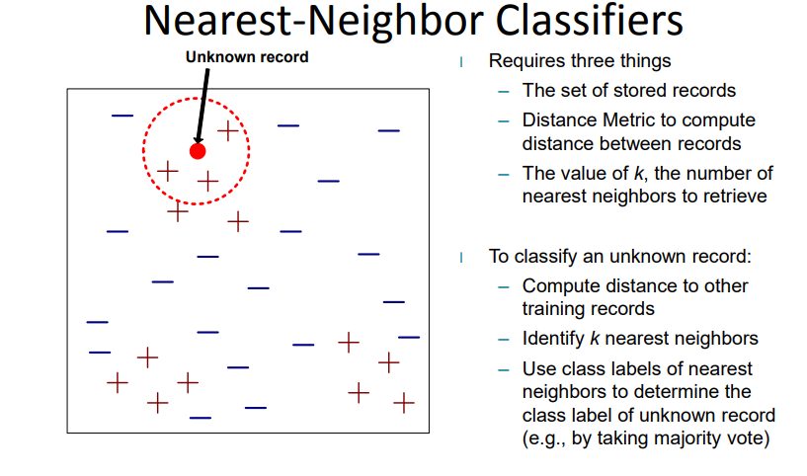

Slide 29
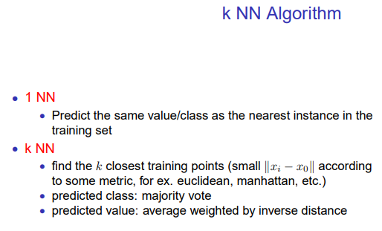
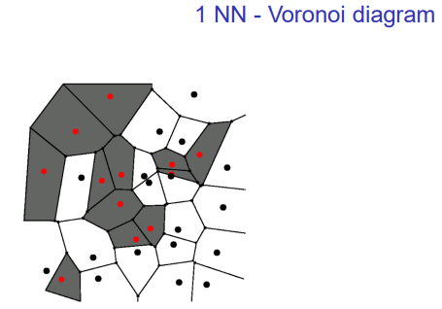
The nearest neighbor algorithm does¬ explicitly compute decision boundaries. However, the decision boundaries form a subset of the Voronoi diagram for the training data.

Slide 30
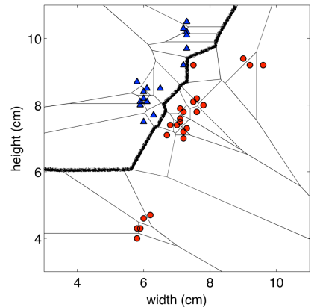
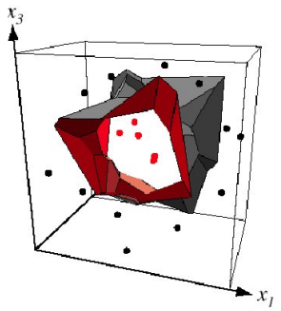
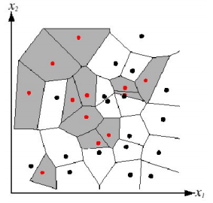
Decision Boundaries

Slide 31
KNN variants in names
•
Instance-Based Learning: The raw training instances are used to make predictions. As such KNN is often referred to as instance-based learning or a case-based learning (where each training instance is a case from the problem domain).
•
Instance-based learning (sometimes called memory-based learning) is a family of learning algorithms that, instead of performing explicit generalization, compares new problem instances with instances seen in training, which have been stored in memory.

Slide 32
KNN variants in names
•
Lazy Learning: No learning of the model is required and all of the work happens at the time a prediction is requested. As such, KNN is often referred to as a lazy learning algorithm.
The generalization beyond the training data is delayed until a query is made to the system
Example,
used by online recommendation systems, is that the data set is continuously updated with new entries.
Because of the continuous update, the "training data" would be rendered obsolete in a relatively short time especially in areas like books and movies, where new best-sellers or hit movies/music are published/ released continuously.
Therefore, one cannot really talk of a "training phase".
•
•

Slide 33
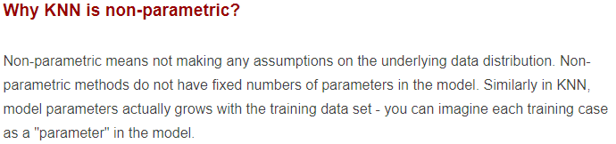
KNN variants in names
Non-Parametric: KNN makes no assumptions about the functional form of the problem being solved. As such KNN is referred to as a non- parametric machine learning algorithm.
Not based solely on parametrized families of probability distributions such as the mean and variance
Example
A histogram is a simple nonparametric estimate of a probability distribution.
KNNs classify the unseen instance based on the K points in the training set which are nearest to it.
•
•

Slide 34
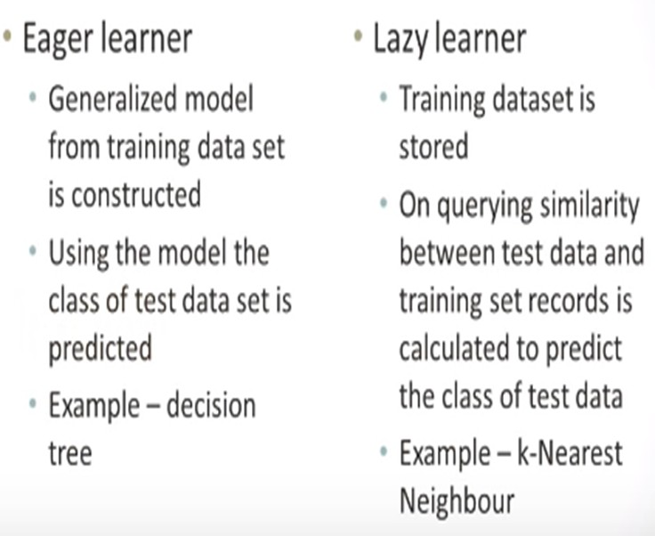
KNN a lazy learner?

Slide 35
Best Prepare Data for KNN
•
Rescale Data: KNN performs much better if all of the data has the same scale. Normalizing your data to the range [0, 1] is a good idea. It may also be a good idea to standardize your data if it has a Gaussian distribution.
Address Missing Data: Missing data will mean that the distance between samples can not be calculated. These samples could be excluded or the missing values could be imputed.
Lower Dimensionality: KNN is suited for lower dimensional data.
You can try it on high dimensional data (hundreds or thousands of input variables) but be aware that it may not perform as well as other techniques.
KNN can benefit from feature selection that reduces the dimensionality of the input feature space.
•
•

Slide 36
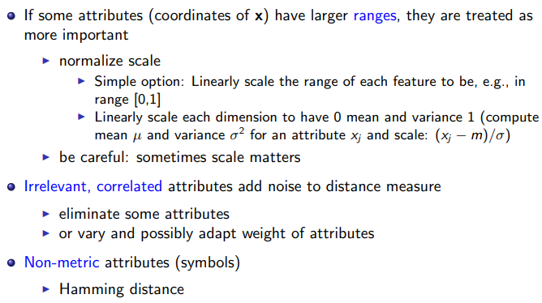
Attributes

Slide 37
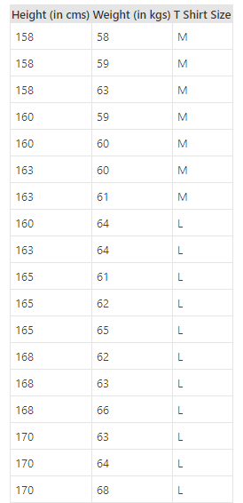
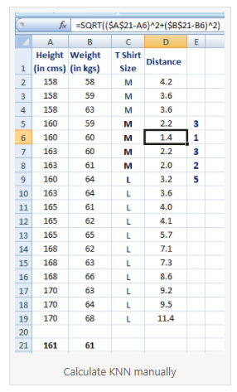

Slide 38
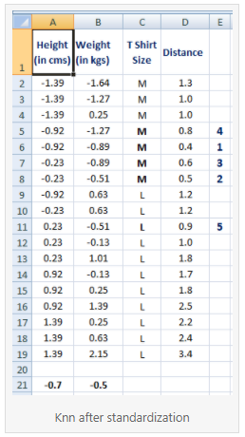
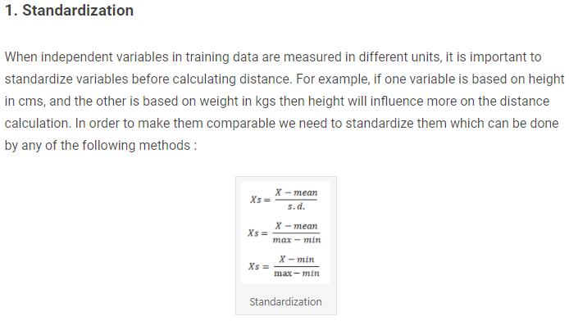

Slide 39
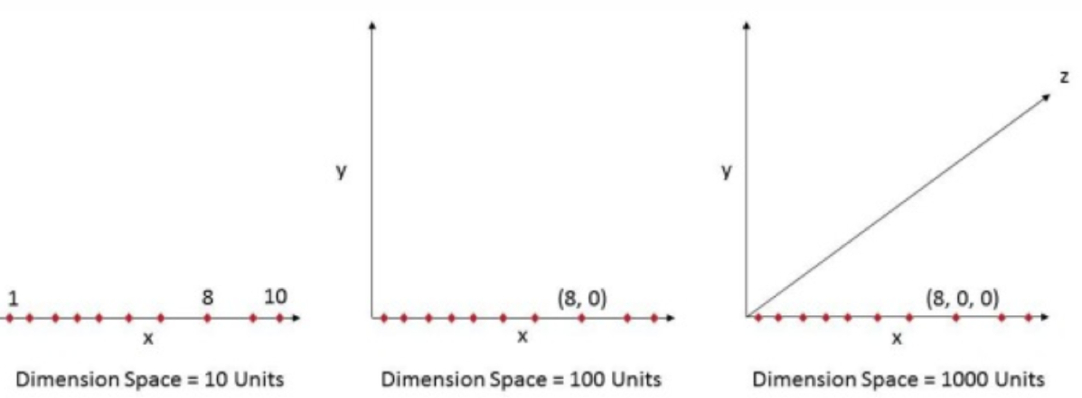
Curse of Dimensionality
"As the number of features or dimensions grows, the amount of data we need to generalize accurately grows exponentially."

Slide 40
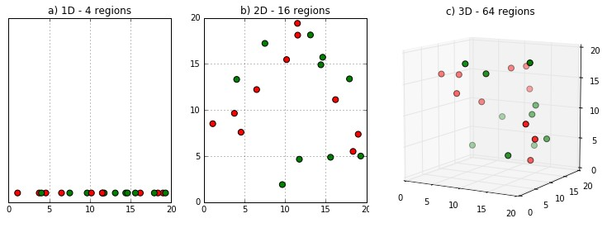
Curse of Dimensionality
•
"As the number of features or dimensions grows, the amount of data we need to generalize accurately gro exponentially."
ws
•
This exponential growth in data causes high sparsity in the data set and unnecessarily increases storage space and processing time for the particular modelling algorithm. Think of image recognition problem of high resolution images 1280
× 720 = 921,600 pixels i.e. 921600 dimensions

Slide 41
Curse of Dimensionality
Value added by additional dimension is much smaller compared to overhead it adds to the algorithm.
The data that can be represented using 10 space units of one true dimension, needs 1000 space units after adding 2 more dimensions just because we observed these dimensions during the experiment.
The true dimension means the dimension which accurately generalize the data and observed dimensions means whatever other dimensions we consider in dataset which may or may not contribute to accurately generalize the data.

Slide 42
Session 2

Slide 43
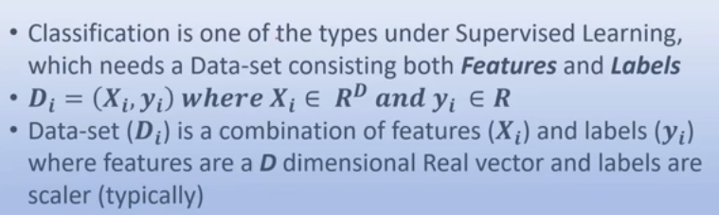
Learning Algorithm

Slide 44
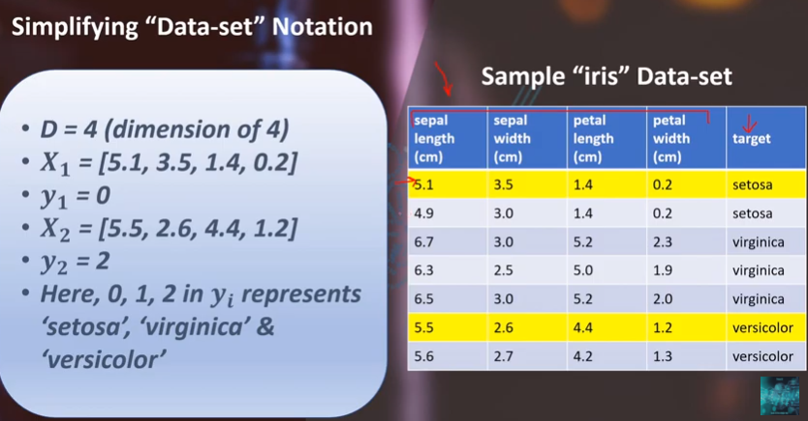
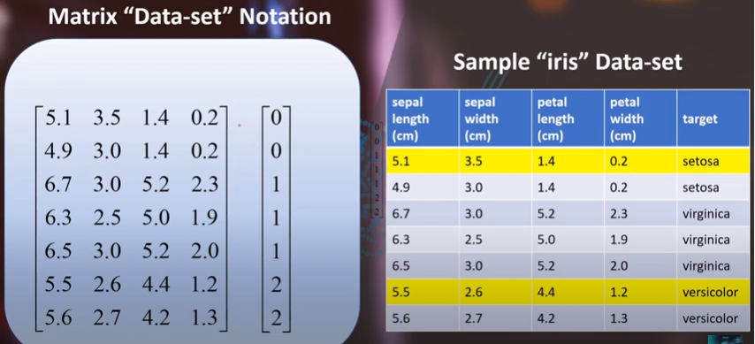

Slide 45
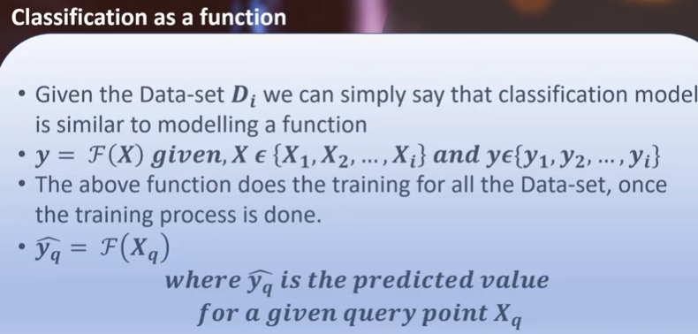

Slide 46

Classification

Slide 47

Distance Measure

Slide 48


Slide 49


Slide 50


Slide 51


Slide 52


Slide 53
How do we choose ‘k’?

Slide 54


Slide 55


Slide 56

Model Fit

Slide 57


Slide 58


Slide 59


Slide 60


Slide 61

Regression

Slide 62


Slide 63


Distance-Weighted KNN
Tradeoff between small and large k can be difficult
Use Large K, but more emphasis on nearest neighbors?

Slide 64


Slide 65
Review Questions
k-NN algorithm does more computation on test time rather than train time ??
TRUE or FALSE
Which of the following statement is true about k-NN algorithm?
k-NN performs much better if all of the data have the same scale
k-NN works well with a small number of input variables (p), but struggles when the number of inputs is very large
k-NN makes no assumptions about the functional form of the problem being solved

Slide 66

Review Questions
Suppose, you have given the following data where x and y are the 2 input variables and Class is the dependent variable.
Suppose, you want to predict the class of new data point x=1 and y=1 using eucludian distance in 3-NN. In which class this data point belong to?
In the previous question, you are now want use 7-NN instead of 3-KNN which of the following x=1 and y=1 will belong to?

Slide 67

Thank You

